Slide 1
Would you prefer to go to a campus university or a city university?

Slide 2
How do university students learn?
Objectives
To describe the different types of courses that can be studied at university
To compare and contrast school learning to university learning

Slide 3
What subject do you want to study at university?

Slide 4
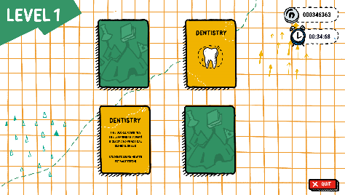
Extension: search the courses that you might want to study in the future. Have a look in a hard copy university prospectus, or google UCAS course search
Notes:
Add Subject Selector screenshot

Slide 6
Venn Diagram
Complete a Venn Diagram on how school learning is different to university learning. Think about:
What you can study
How you study
How you are examined
What skills you need
Who you work with
And more!
Use the script from Dr Jane Henderson
Extension: What top 5 tips would you give to a student who is about to start university study?

Slide 7
Design a University Prospectus
A prospectus is a booklet that tells pupils about a university, the courses available and how students learn.
Create a University prospectus where you include:
5 courses that can be studied at your university
5 ways in which university study is different to school study
Also include information you learned in the last session. Is it a campus or a city university? Who goes there? What buildings are there?

Slide 8
Tweet King’s
College London!
Sum up in no more than 3 lines either:
What courses you can study at university
How university learning is different to school learning
The best ones can be tweeted to @KCLWP by your teacher!

