Slide 1
What are the similarities between school learning and university learning?

Slide 2
How do university students live?
Objectives
To calculate a weekly student budget
To explain why university study is affordable
To explain how students spend their time

Slide 3
Is university expensive?

Slide 4
https://www.youtube.com/watch?v=mPpfjKY2QC0
Notes:
Homework

Slide 6
You can also apply for….
Scholarships. A fund given to a student who has shown themselves to be very good at a particular subject or skill. They do not need to be paid back
Bursaries. A means-tested fund given to students. ‘Means-tested’ means that they meet some sort of criteria, such as household income or disability. Students do not have to pay this money back
Hardship funds. A fund held by universities that students may access if they fall on hard times and require short-term financial assistance

Slide 7
Is university expensive?

Slide 8
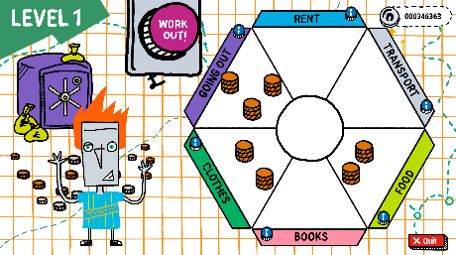

Slide 9
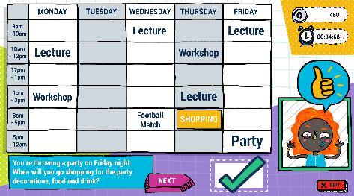
Extension:
How does a university timetable differ from your school timetable?
What do you have to do as a university student which you may not have to do now?
Compare and contrast the experience of an arts and humanities student, with a science student. Which timetable do you think you’d prefer and why?

Slide 10
Design a University Society
A university society is a student club, created by students, for students. They hold events, raise money for charities, and provide a social space for students.
Design your own university society. Include:
The name of your society
What your society is about
How you would encourage people to join your society
What you would do when your members meet up
(or)
Write a diary entry as a University Student. Include:
What learning you have done today
What chores you have done
What social activities you have enjoyed
(or)
Design a Student Finance Guide that explains why university is affordable. Use the help sheet.

Slide 11
Tweet King’s
College London!
Sum up in no more than 3 lines either:
Why university study is affordable
How university students spend their time
The best ones can be tweeted to @KCLWP by your teacher!

