Slide 1
Explain why you should go to university

Slide 2
How do I get to University?
Objectives
To describe the types of extra-curricular activity that you can do to help you access a top university
To explain the steps you will take to access a fantastic university

Slide 3
What steps do you need to take to get to university?

Slide 4
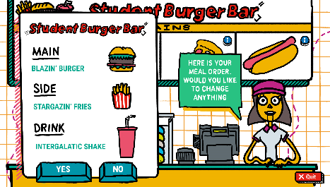

Slide 5
Article Discussion
Reading widely, and discussing news issues outside of school is something that Universities love their students to do.
In groups, read an article.
Summarise it in 5 lines
Explain what you found interesting about it
Extension:
Find another article in a newspaper or online.
Summarise it in 5 lines
Explain what you found interesting about it

Slide 6
Alongside extra-curricular reading and discussion, you also need fantastic GCSE results.

Slide 7
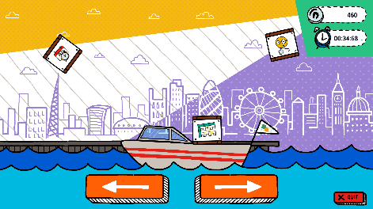

Slide 8
How do I get to University?
Information Hunt
Leave your sheets at the desk
Move around the room and read the information
Note down the information on your sheets
Extension: Rank each skill/resource in order. Which is the most important thing needed to get to university? Explain your answer.

Slide 9
Action Plan
Write an ‘Action Plan’ to help you get to university.
Make sure:
It is realistic
It is ambitious
You include extracurricular and in-school actions
Extension:
Rank your actions in order of importance
Summarise your action plan in 1 sentence

Slide 10
Tweet King’s
College London!
Sum up in no more than 3 lines the Action Plan that will take you to university.
The best ones can be tweeted to @KCLWP by your teacher!

