Slide 1
1. Draw a typical ‘university professor’ and a typical ‘university student’
2. List all the people who live or work in a university

Slide 2
What is a university and who is there?
Objectives
To describe who and what is at a university
To explain the differences between campus and city universities, and between living at home or at university

Slide 3
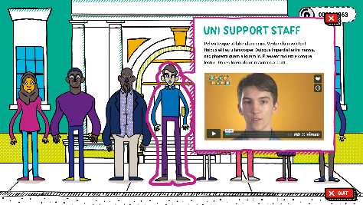

Slide 4
Character Profiles
Using the templates provided, complete 2 Character Profiles
Choose 2 ‘Meet the Cast’ characters. Watch their videos and read their scripts
Extension: In what ways is being a student at university different to being a pupil in a school?

Slide 6
Note down what happens in each building on your maps
Extension: What is the difference between a ‘Campus’ and a ‘City’ University. Note down some ideas

Slide 7
Living Arrangements
You have 5 mins to read and make notes
Number 1s read ‘Campus vs. City’
Number 2s read ‘Home vs. Uni’
Then you will have 5 mins to teach your partner all that you’ve learned
Extension: Debate between you which you’d prefer and why

Slide 8
Design a University Postcard!
On the front draw a university, including key buildings. (and consider, is it a Campus or City university?)
On the back pupils write a postcard to a friend. Explain:
Who is at the university
What the university looks like
What buildings are there
Whether it is a campus or a city university
Whether they live at home or at university
Extension: write a short pitch explaining why their university is a fantastic place to study and live.

Slide 9
Tweet King’s
College London!
Sum up in no more than 3 lines either:
1.Who is at university
2.What is at a university
3.The difference between a campus university
The best ones can be tweeted to @KCLWP by your teacher!

