Slide 1
Explain how students can fund their study at university

Slide 2
Why should I go to University?
Objectives
To describe the benefits of going to university
To explain how different degrees lead to different careers

Slide 3
Why should you go to Uni?

Slide 4
Why should you go to Uni?
Information Hunt
Leave your sheets at the desk
Move around the room and read the information
Note down the information on your sheets
Extension: Rank the reasons in order for you. Then have a debate with the person next to you. Do you agree?

Slide 5
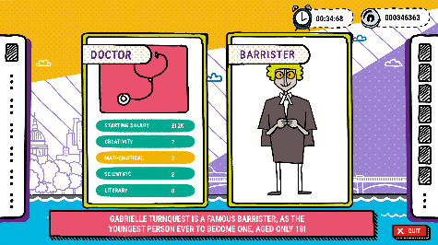
Play Future me! You can play it online, or using the paper cards.
Extension: Visit https://nationalcareersservice.direct.gov.uk/job-profiles/home. Find 3 jobs that may interest you. Explain why they interest you

Slide 6
Speech Writing
Write a speech explaining why you should go to university. You could include:
Course enjoyment
Social life
Study abroad
Career
Developing transferrable skills
Developing independence
Extension:
Swap your speech with a partner. In a different colour, add in any benefits they may have missed
Explain the MOST IMPORTANT reason why you should go to university

Slide 7
Tweet King’s
College London!
Sum up in no more than 3 lines why you should go to university.
The best ones can be tweeted to @KCLWP by your teacher!

